Slide 1
CPSC 440
§3.1 Introduction
Chapter 4: The Processor
(part 1)*
* This ppt is provided by the publisher of the textbook
Notes:
Morgan Kaufmann Publishers
Chapter 3 — Arithmetic for Computers

Slide 2
Introduction
§4.1 Introduction
CPU performance factors
  Instruction count
    Determined by ISA and compiler
  CPI and Cycle time
    Determined by CPU hardware
We will examine two MIPS implementations
  A simplified version
  A more realistic pipelined version
Simple subset, shows most aspects
  Memory reference: lw, sw
  Arithmetic/logical: add, sub, and, or, slt
  Control transfer: beq, j
Chapter 4 — The Processor — <number>
Notes:
Morgan Kaufmann Publishers
Chapter 4 — The Processor

Slide 3
Instruction Execution
PC → instruction memory, fetch instruction
Register numbers → register file, read registers
Depending on instruction class
  Use ALU to calculate
    Arithmetic result
    Memory address for load/store
    Branch target address
  Access data memory for load/store
  PC ← target address or PC + 4
Chapter 4 — The Processor — <number>
Notes:
Morgan Kaufmann Publishers
Chapter 4 — The Processor

Slide 4
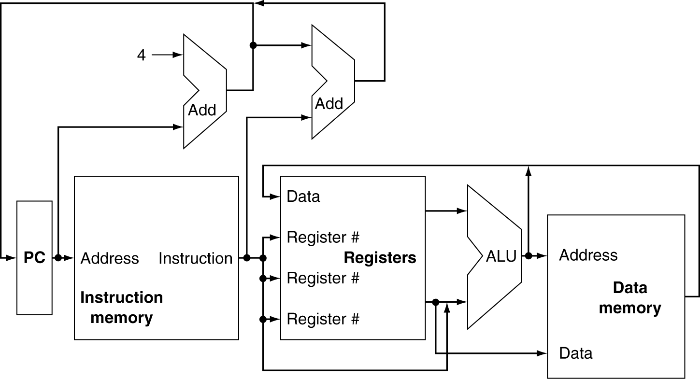
CPU Overview
Chapter 4 — The Processor — <number>
Notes:
Morgan Kaufmann Publishers
Chapter 4 — The Processor

Slide 5
Multiplexers
Can’t just join wires together
  Use multiplexers
Chapter 4 — The Processor — <number>
Notes:
Morgan Kaufmann Publishers
Chapter 4 — The Processor

Slide 6
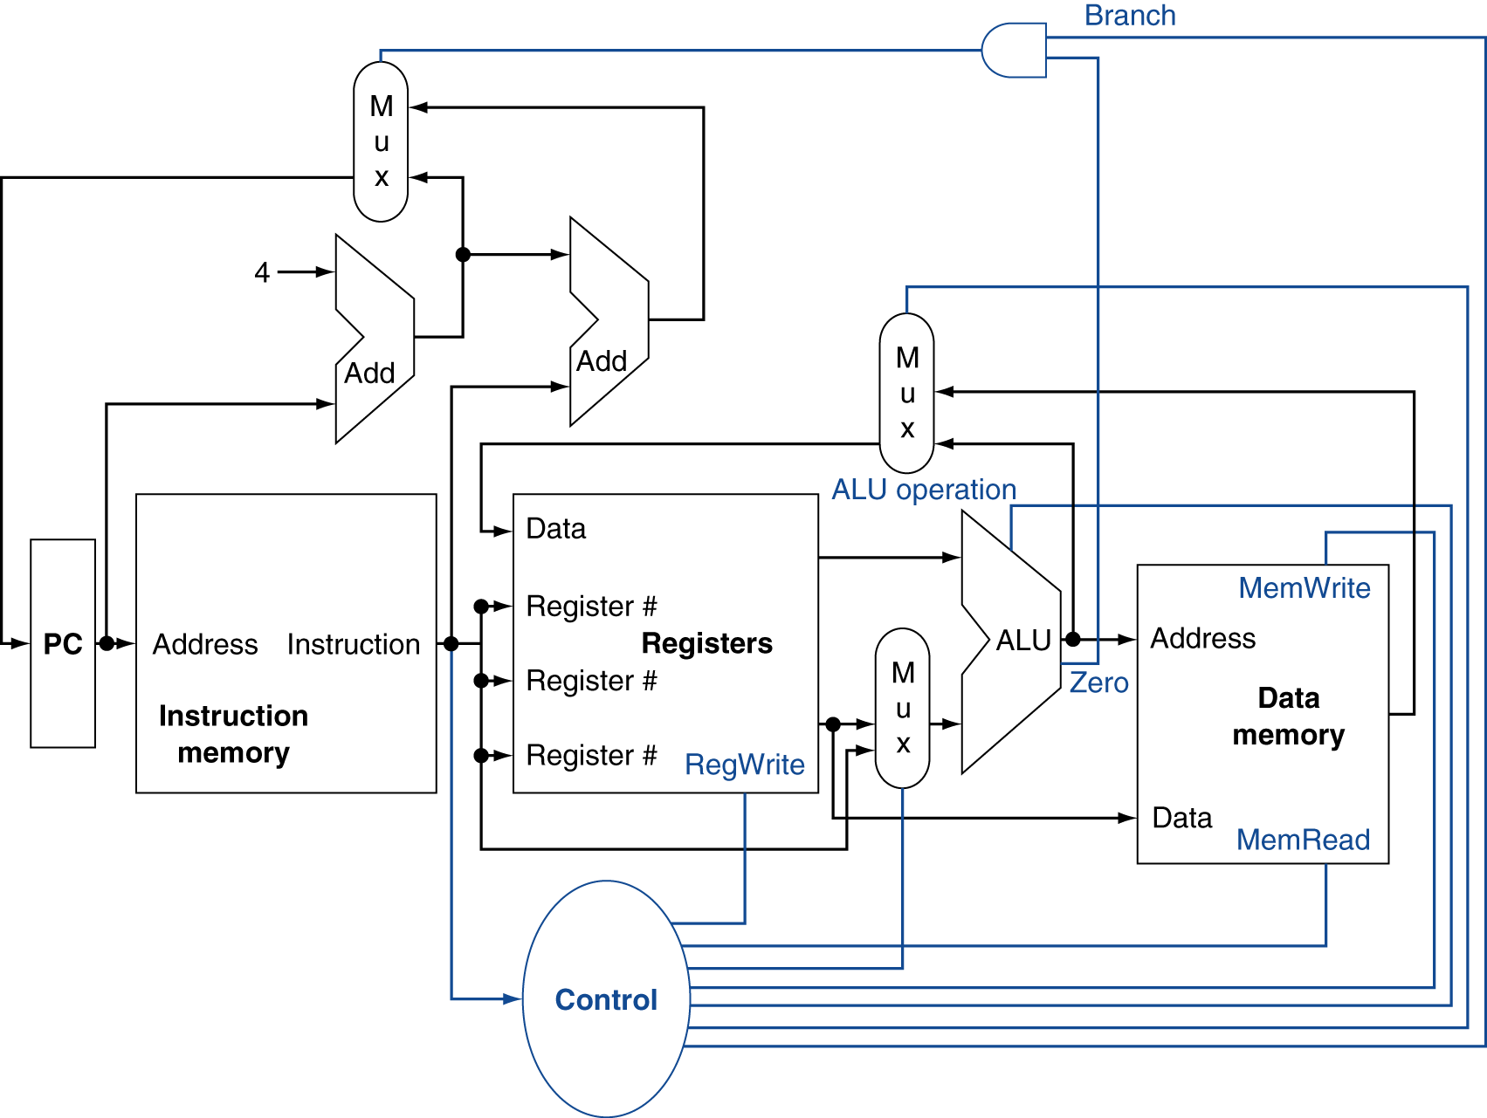
Control
Chapter 4 — The Processor — <number>
Notes:
Morgan Kaufmann Publishers
Chapter 4 — The Processor

Slide 7
Logic Design Basics
Information encoded in binary
  Low voltage = 0, High voltage = 1
  One wire per bit
  Multi-bit data encoded on multi-wire buses
Combinational element
  Operate on data
  Output is a function of input
State (sequential) elements
  Store information
§4.2 Logic Design Conventions
Chapter 4 — The Processor — <number>
Notes:
Morgan Kaufmann Publishers
Chapter 4 — The Processor

Slide 8
Combinational Elements
AND-gate
  Y = A & B
Adder
  Y = A + B
A
+
Y
B
A
Y
B
Arithmetic/Logic Unit
  Y = F(A, B)
Multiplexer
  Y = S ? I1 : I0
A
I0
M
u
x
Y
Y
ALU
I1
B
S
F
Chapter 4 — The Processor — <number>
Notes:
Morgan Kaufmann Publishers
Chapter 4 — The Processor

Slide 9
Sequential Elements
Register: stores data in a circuit
  Uses a clock signal to determine when to update the stored value
  Edge-triggered: update when Clk changes from 0 to 1
Clk
D
Q
D
Clk
Q
Chapter 4 — The Processor — <number>
Notes:
Morgan Kaufmann Publishers
Chapter 4 — The Processor

Slide 10
Sequential Elements
Register with write control
  Only updates on clock edge when write control input is 1
  Used when stored value is required later
Clk
D
Q
Write
Write
D
Clk
Q
Chapter 4 — The Processor — <number>
Notes:
Morgan Kaufmann Publishers
Chapter 4 — The Processor

Slide 11
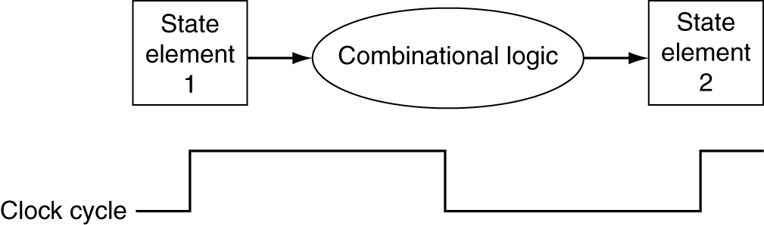
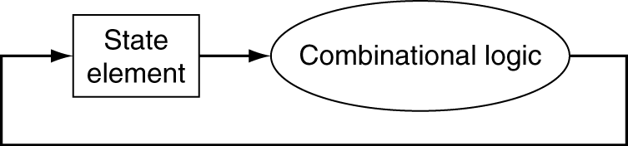
Clocking Methodology
Combinational logic transforms data during clock cycles
  Between clock edges
  Input from state elements, output to state element
  Longest delay determines clock period
Chapter 4 — The Processor — <number>
Notes:
Morgan Kaufmann Publishers
Chapter 4 — The Processor

Slide 12
Building a Datapath
Datapath
  Elements that process data and addresses
  in the CPU
    Registers, ALUs, mux’s, memories, …
We will build a MIPS datapath incrementally
  Refining the overview design
§4.3 Building a Datapath
Chapter 4 — The Processor — <number>
Notes:
Morgan Kaufmann Publishers
Chapter 4 — The Processor

Slide 13
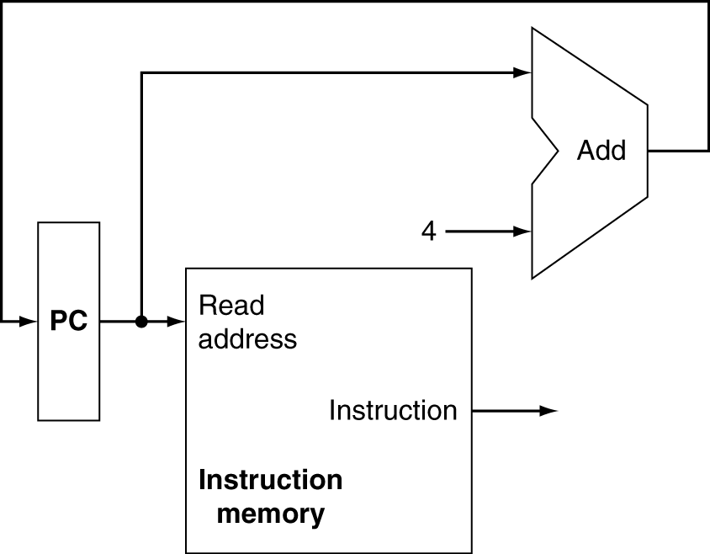
Instruction Fetch
Increment by 4 for next instruction
32-bit register
Chapter 4 — The Processor — <number>
Notes:
Morgan Kaufmann Publishers
Chapter 4 — The Processor

Slide 14
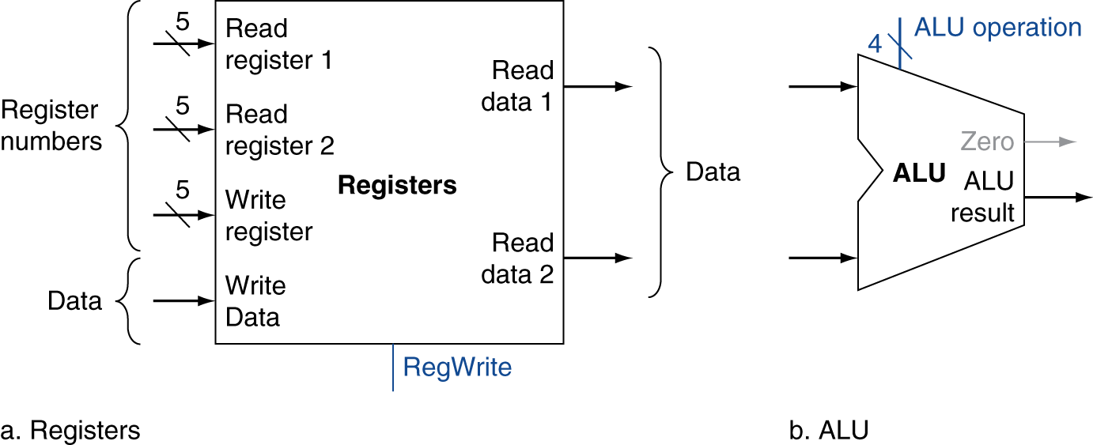
R-Format Instructions
Read two register operands
Perform arithmetic/logical operation
Write register result
Chapter 4 — The Processor — <number>
Notes:
Morgan Kaufmann Publishers
Chapter 4 — The Processor

Slide 15
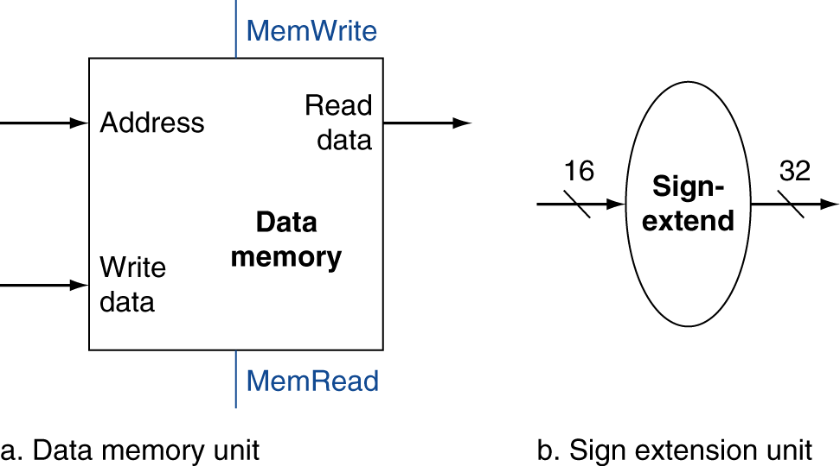
Load/Store Instructions
Read register operands
Calculate address using 16-bit offset
  Use ALU, but sign-extend offset
Load: Read memory and update register
Store: Write register value to memory
Chapter 4 — The Processor — <number>
Notes:
Morgan Kaufmann Publishers
Chapter 4 — The Processor

Slide 16
Branch Instructions
Read register operands
Compare operands
  Use ALU, subtract and check Zero output
Calculate target address
  Sign-extend displacement
  Shift left 2 places (word displacement)
  Add to PC + 4
    Already calculated by instruction fetch
Chapter 4 — The Processor — <number>
Notes:
Morgan Kaufmann Publishers
Chapter 4 — The Processor

Slide 17
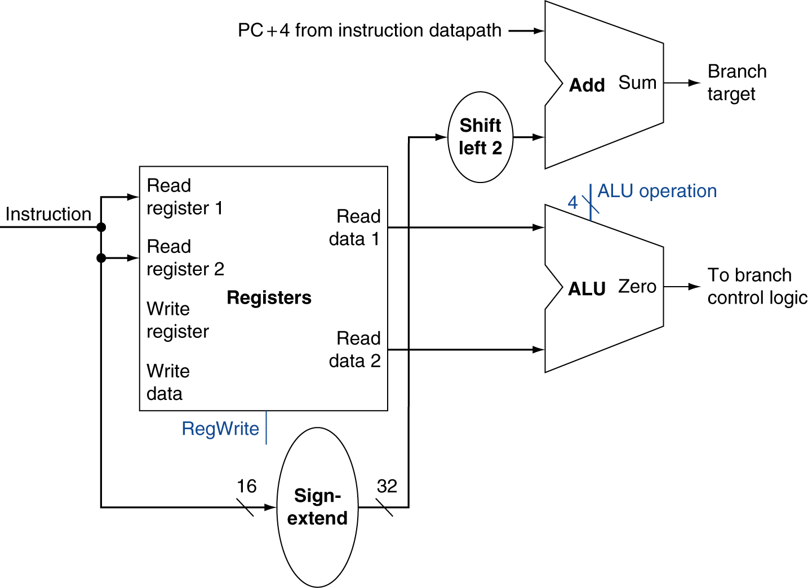
Branch Instructions
Just
re-routes wires
Sign-bit wire replicated
Chapter 4 — The Processor — <number>
Notes:
Morgan Kaufmann Publishers
Chapter 4 — The Processor

Slide 18
Composing the Elements
First-cut data path does an instruction in one clock cycle
  Each datapath element can only do one function at a time
  Hence, we need separate instruction and data memories
Use multiplexers where alternate data sources are used for different instructions
Chapter 4 — The Processor — <number>
Notes:
Morgan Kaufmann Publishers
Chapter 4 — The Processor

Slide 19
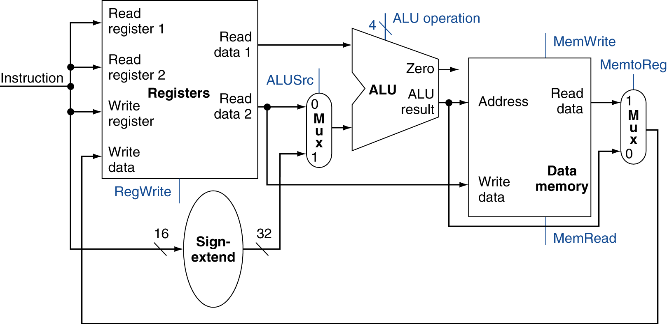
R-Type/Load/Store Datapath
Chapter 4 — The Processor — <number>
Notes:
Morgan Kaufmann Publishers
Chapter 4 — The Processor

Slide 20
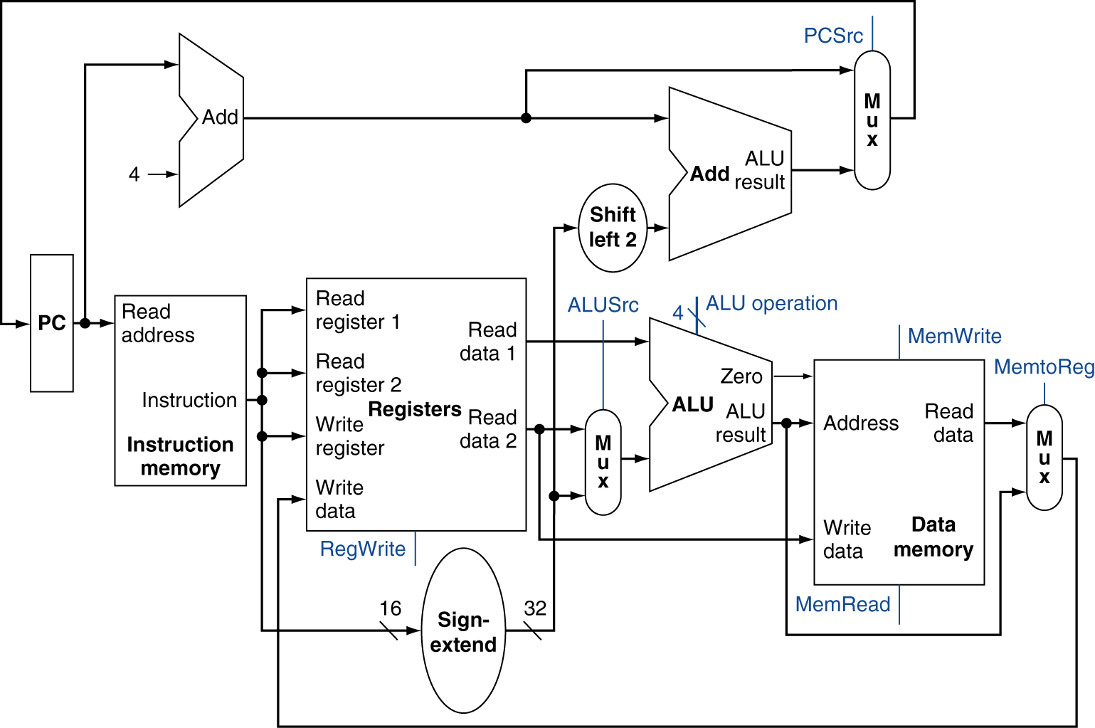
Full Datapath
Chapter 4 — The Processor — <number>
Notes:
Morgan Kaufmann Publishers
Chapter 4 — The Processor

Slide 21
ALU Control
ALU used for
  Load/Store: F = add
  Branch: F = subtract
  R-type: F depends on funct field
§4.4 A Simple Implementation Scheme
ALU control | Function
0000 | AND
0001 | OR
0010 | add
0110 | subtract
0111 | set-on-less-than
1100 | NOR
Chapter 4 — The Processor — <number>
Notes:
Morgan Kaufmann Publishers
Chapter 4 — The Processor

Slide 22
ALU Control
Assume 2-bit ALUOp derived from opcode
  Combinational logic derives ALU control
opcode | ALUOp | Operation | funct | ALU function | ALU control
lw | 00 | load word | XXXXXX | add | 0010
sw | 00 | store word | XXXXXX | add | 0010
beq | 01 | branch equal | XXXXXX | subtract | 0110
R-type | 10 | add | 100000 | add | 0010
 |  | subtract | 100010 | subtract | 0110
 |  | AND | 100100 | AND | 0000
 |  | OR | 100101 | OR | 0001
 |  | set-on-less-than | 101010 | set-on-less-than | 0111
Chapter 4 — The Processor — <number>
Notes:
Morgan Kaufmann Publishers
Chapter 4 — The Processor

Slide 23
The Main Control Unit
Control signals derived from instruction
R-type
0
rs
rt
rd
shamt
funct
31:26
25:21
20:16
15:11
10:6
5:0
Load/
Store
35 or 43
rs
rt
address
31:26
25:21
20:16
15:0
Branch
4
rs
rt
address
31:26
25:21
20:16
15:0
opcode
always read
read, except for load
write for R-type and load
sign-extend and add
Chapter 4 — The Processor — <number>
Notes:
Morgan Kaufmann Publishers
Chapter 4 — The Processor

Slide 24
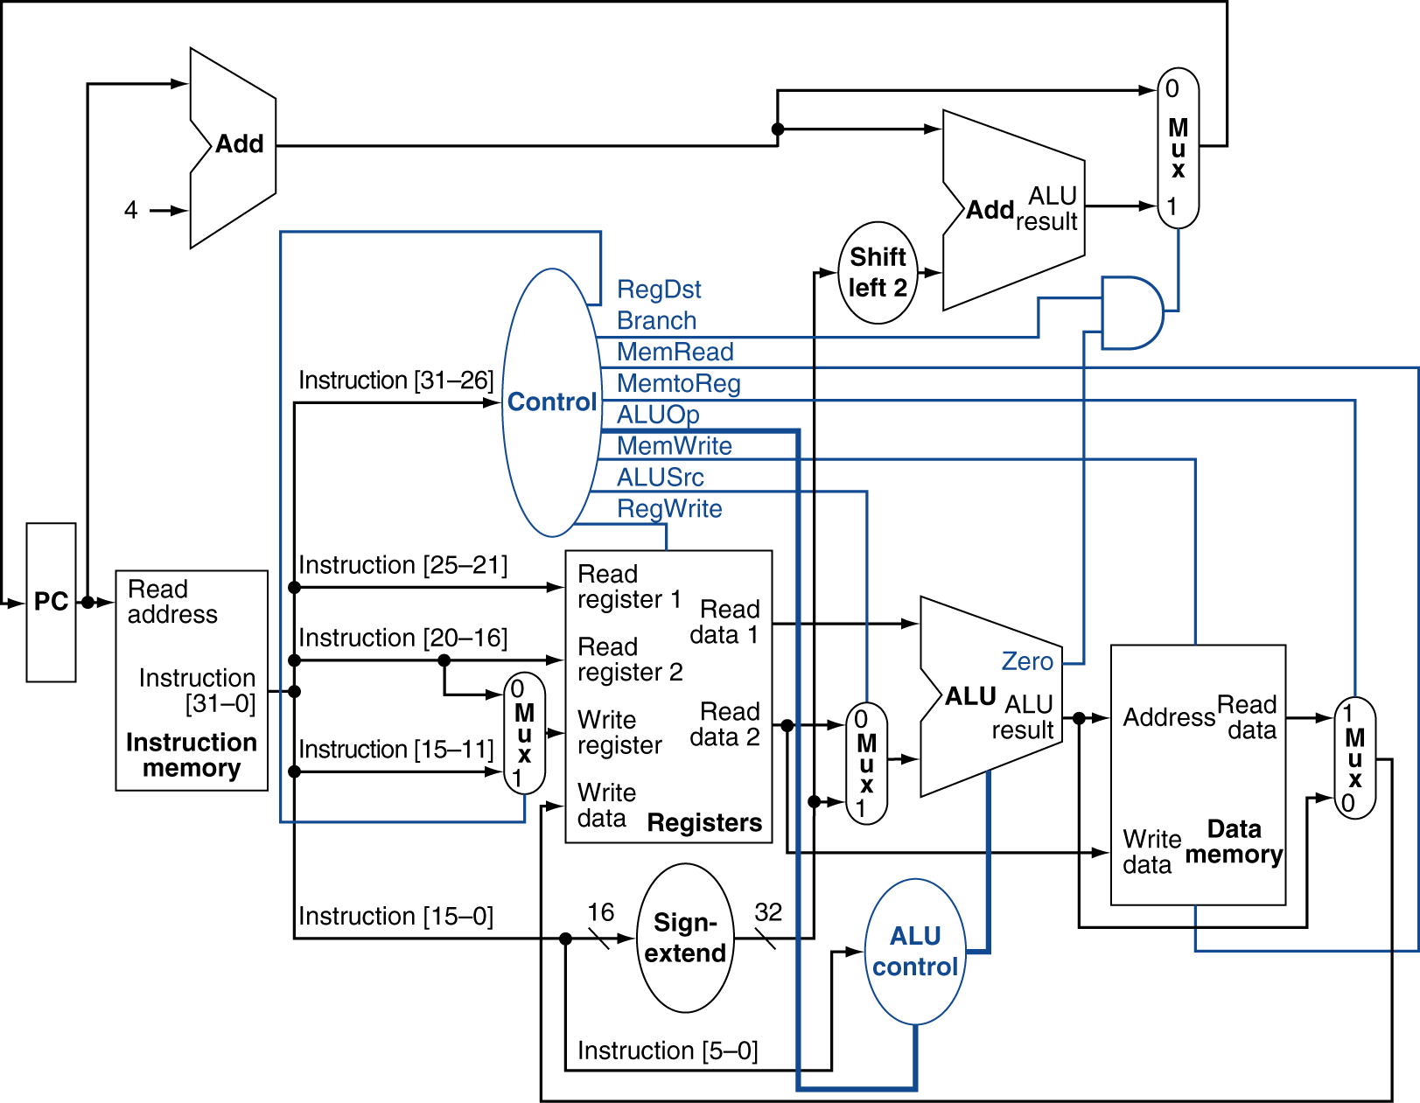
Datapath With Control
Chapter 4 — The Processor — <number>
Notes:
Morgan Kaufmann Publishers
Chapter 4 — The Processor

Slide 25
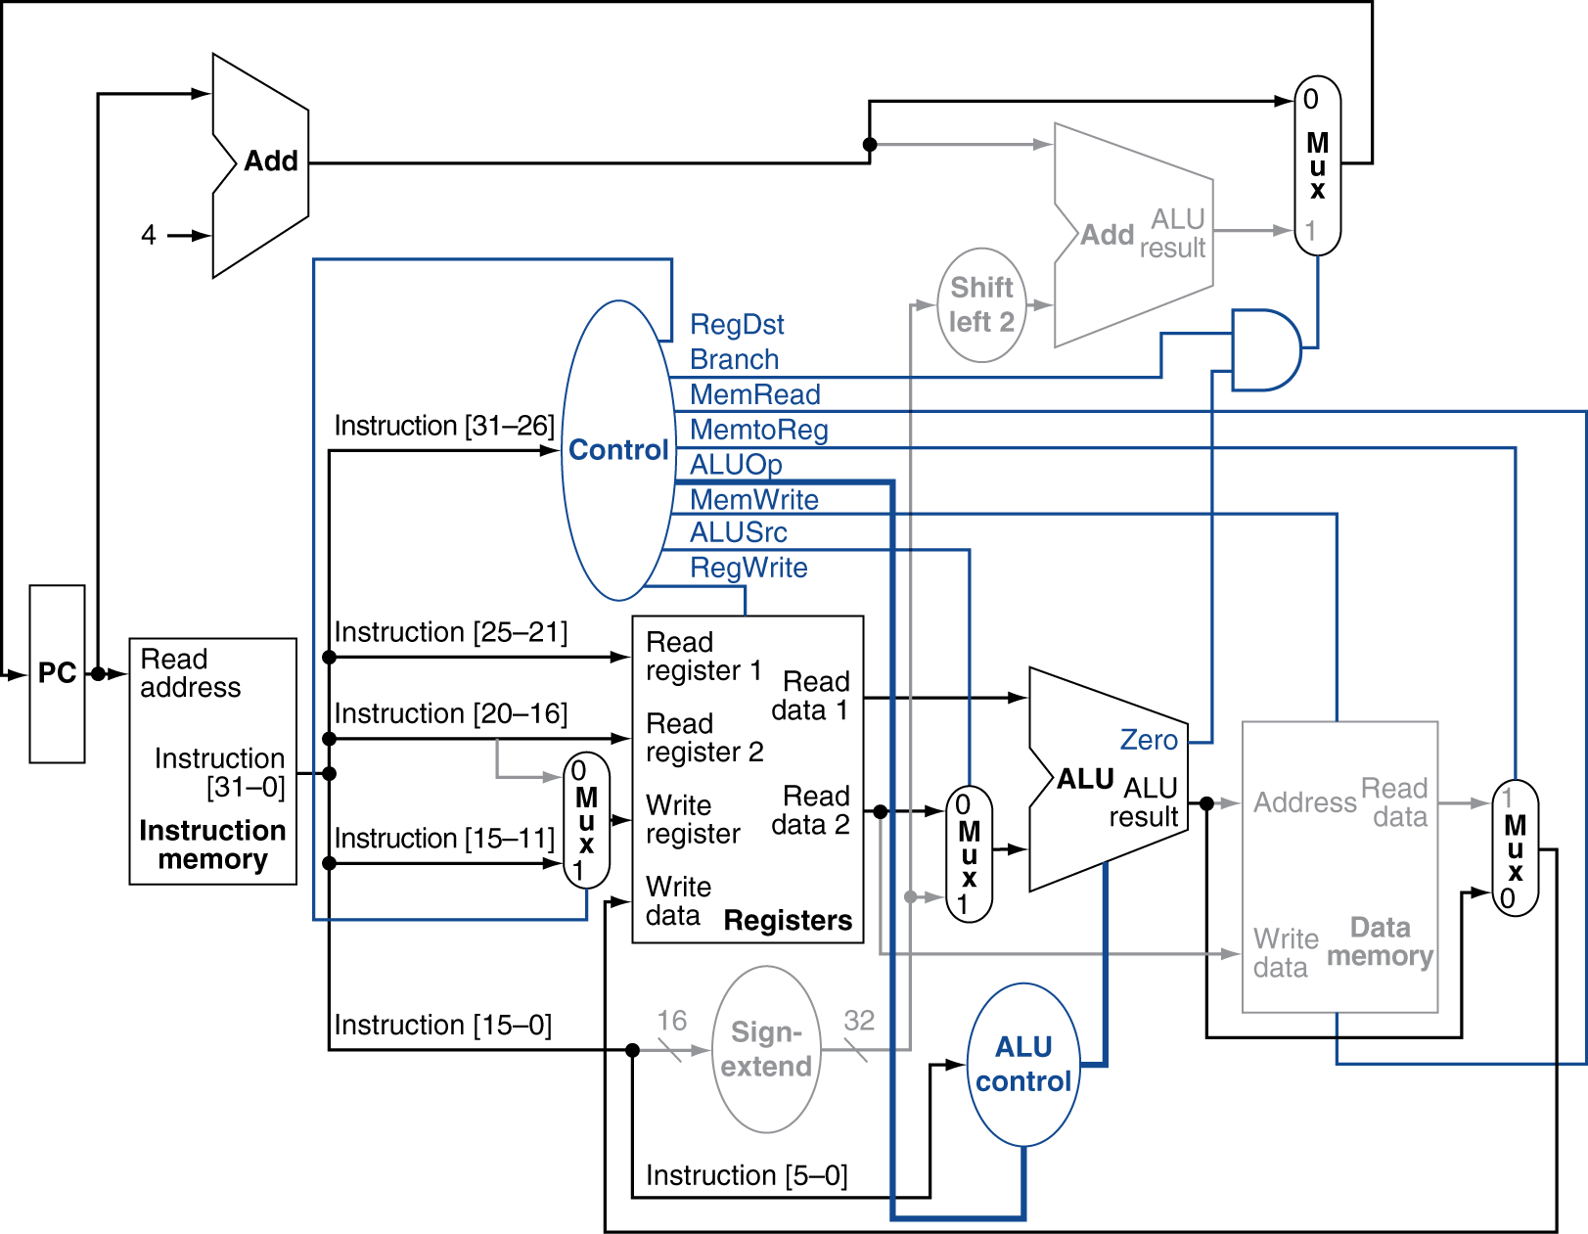
R-Type Instruction
Chapter 4 — The Processor — <number>
Notes:
Morgan Kaufmann Publishers
Chapter 4 — The Processor

Slide 26
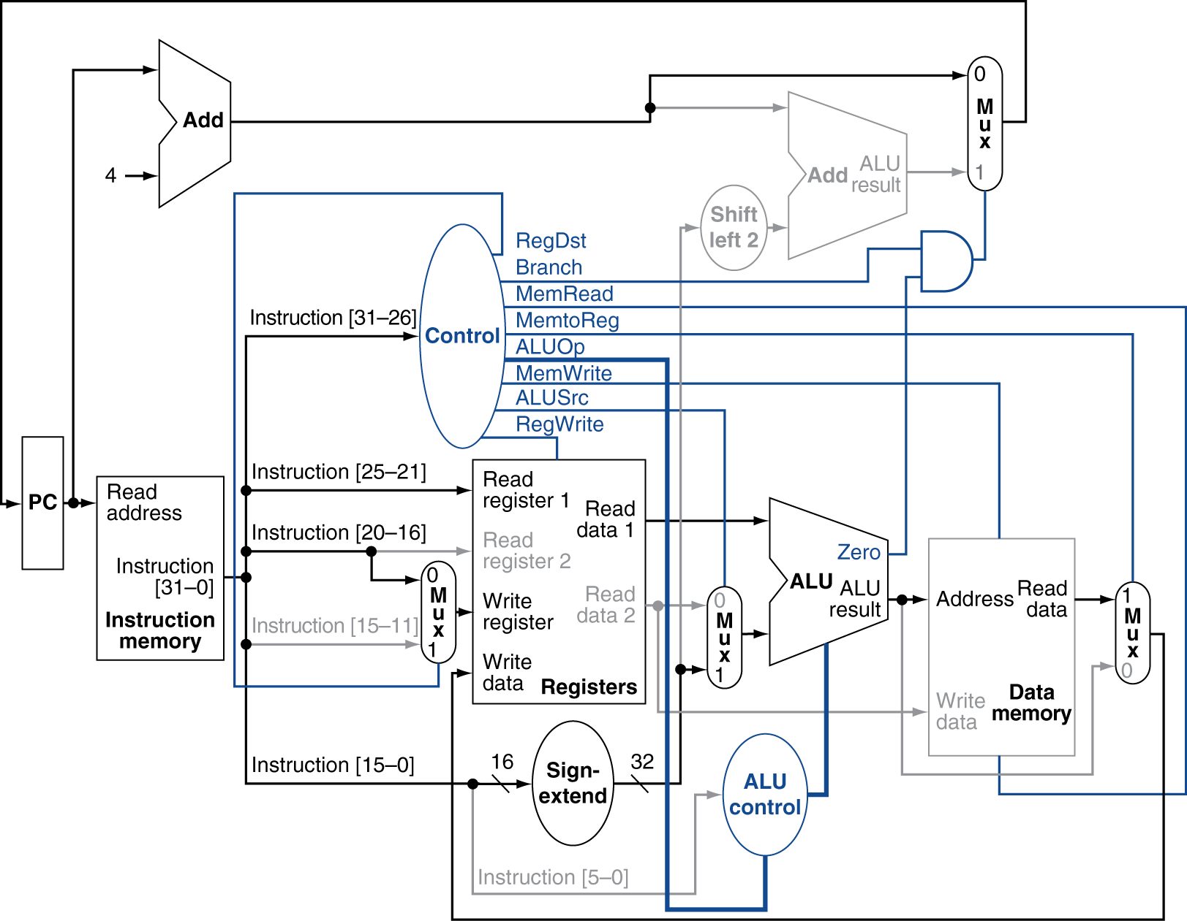
Load Instruction
Chapter 4 — The Processor — <number>
Notes:
Morgan Kaufmann Publishers
Chapter 4 — The Processor

Slide 27
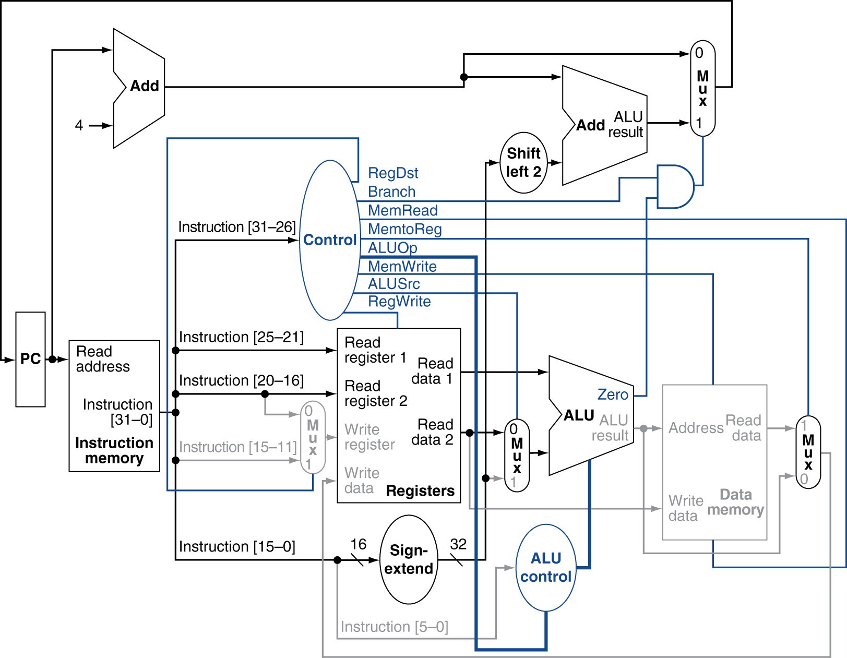
Branch-on-Equal Instruction
Chapter 4 — The Processor — <number>
Notes:
Morgan Kaufmann Publishers
Chapter 4 — The Processor

Slide 28
Implementing Jumps
Jump
2
address
31:26
25:0
Jump uses word address
Update PC with concatenation of
  Top 4 bits of old PC
  26-bit jump address
  00
Need an extra control signal decoded from opcode
Chapter 4 — The Processor — <number>
Notes:
Morgan Kaufmann Publishers
Chapter 4 — The Processor

Slide 29
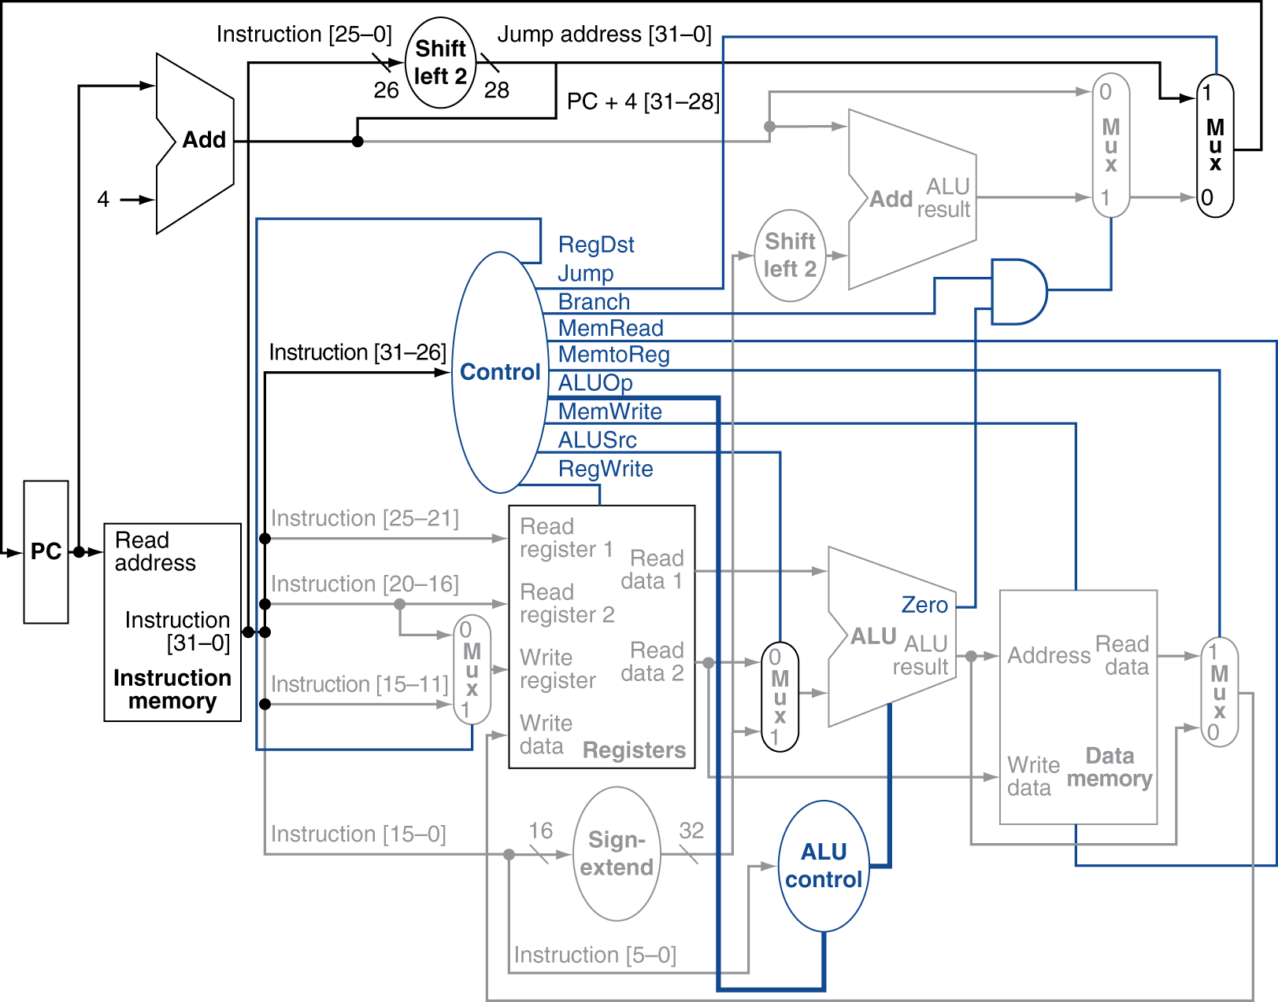
Datapath With Jumps Added
Chapter 4 — The Processor — <number>
Notes:
Morgan Kaufmann Publishers
Chapter 4 — The Processor

Slide 30
Performance Issues
Longest delay determines clock period
  Critical path: load instruction
  Instruction memory → register file → ALU → data memory → register file
Not feasible to vary period for different instructions
Violates design principle
  Making the common case fast
We will improve performance by pipelining
Chapter 4 — The Processor — <number>
Notes:
Morgan Kaufmann Publishers
Chapter 4 — The Processor

